Slide 1
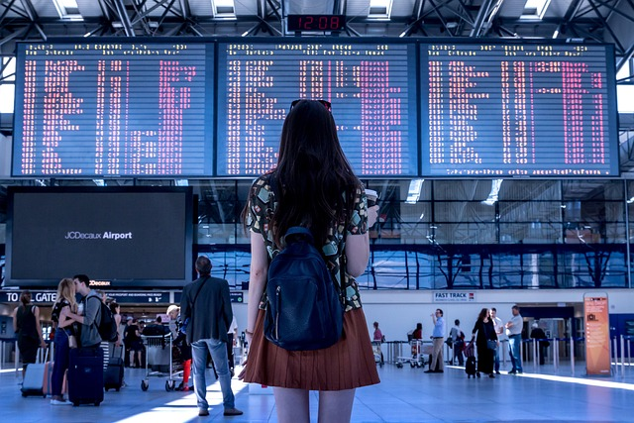
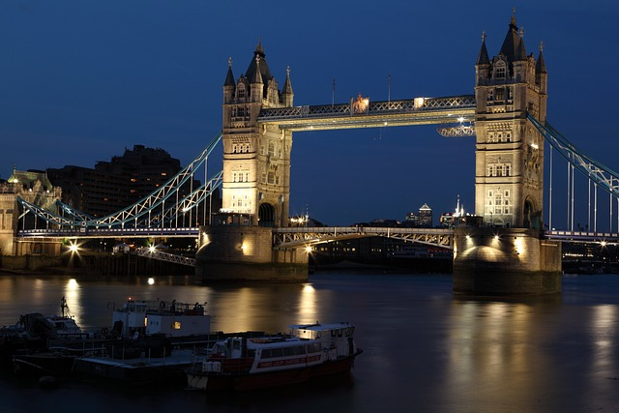
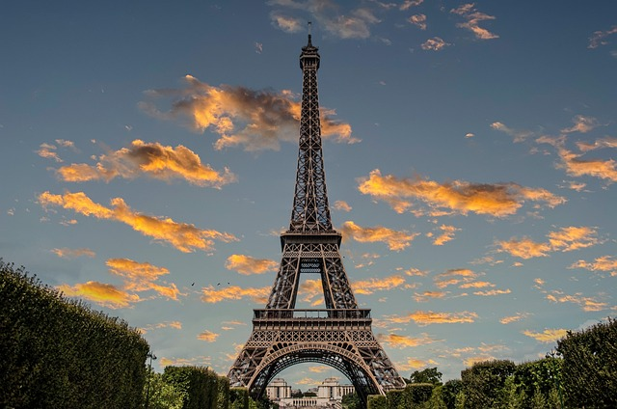
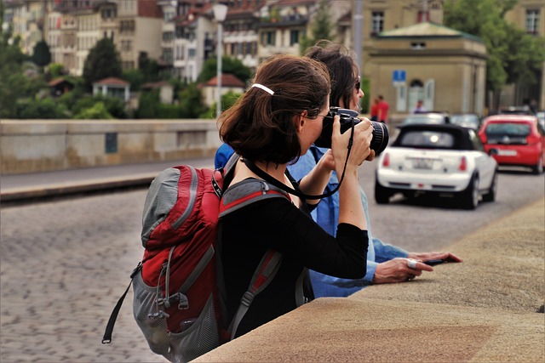
TOPIC: TRAVELING
FOCUS: grammar, Present perfect tense, speaking
Level: B1
WARMER: Describe the images.
Where are the people? What are they doing?
Do you have the same or similar experiences?

Slide 2
TOPIC: TRAVELING
FOCUS: grammar, Present perfect tense, speaking
Level: B1
TEACHERS ONLY:
WARMER: Describe the images.
Where are the people? What are they doing?
Do you have the same or similar experiences?
- Ask the student to read and answer the questions.
- Additional questions:
Have you ever been to the UK/France?
Have you ever seen the Eiffel tower/London Bridge?
Have you ever travelled by plane?
Have you ever taken a photo that you really liked?
(For group lessons, you can ask students, “What other places have you visited?”

Slide 3
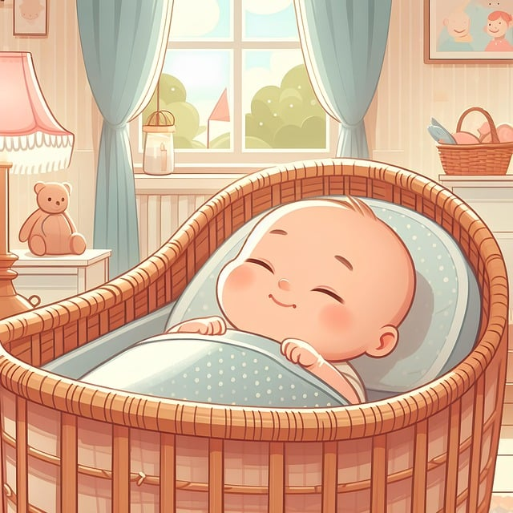
We use the present perfect tense to talk about experiences we have had at an unspecified
time in the past. These experiences are part of our life up to now.
Structure:
Positive: Subject + have/has + past participle + object
(e.g., I have visited Paris.) - we don’t know when
Negative: Subject + have/has not (haven't/hasn't) + past participle + object.
(e.g., I have never visited Paris.)
Question: Have/Has + subject + ever + past participle + object?
(e.g., Have you ever visited Paris?)
NOW

Slide 4
TEACHERS ONLY:
We use the present perfect tense to talk about experiences we have had at an unspecified
time in the past. These experiences are part of our life up to now.
Structure:
Positive: Subject + have/has + past participle + object
(e.g., I have visited Paris.) - we don’t know when
Negative: Subject + have/has not (haven't/hasn't) + past participle + object.
(e.g., I have never visited Paris.)
Question: Have/Has + subject + ever + past participle + object?
(e.g., Have you ever visited Paris?)
You can use the timeline on this or the next slide to explain to students that we use present perfect tense to talk about experiences we had, or did not have from the moment we were born until now, or at the time in the past that is not specified (we don’t know when).
At this stage, you don’t need to explain what the past participle is, as this will be explained on the next slide.
NOW

Slide 5

NOW
NOW

Slide 6

Past participle
As you can see below, we need a PAST PARTICIPLE for make a sentence in Present perfect tense.
Look at the example below, WHAT IS A PAST PARTICIPLE?
Positive: Subject + have/has + past participle + object. (e.g., I have visited Paris.)

Slide 7
What is a Past Participle?
We often say that Past Participle is an –ED verb, and that is correct for REGULAR verbs.
REGULAR VERBS IRREGULAR VERBS
WALK – WALKED. GO – WENT – GONE
We add – ED to a base verb, if a verb is REGULAR or use the third form of an irregular verb.

Slide 8
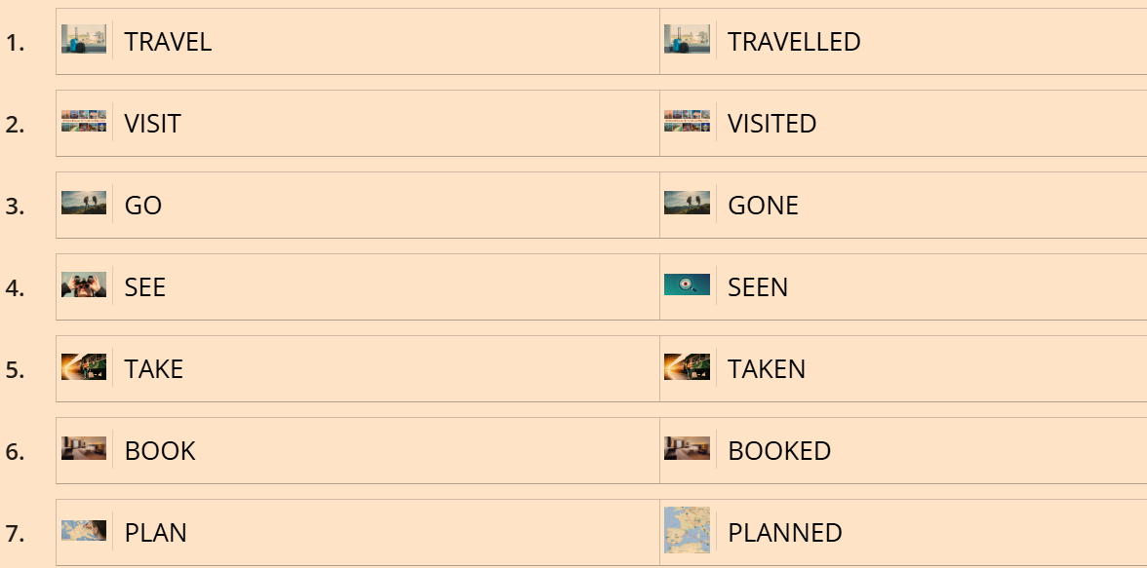
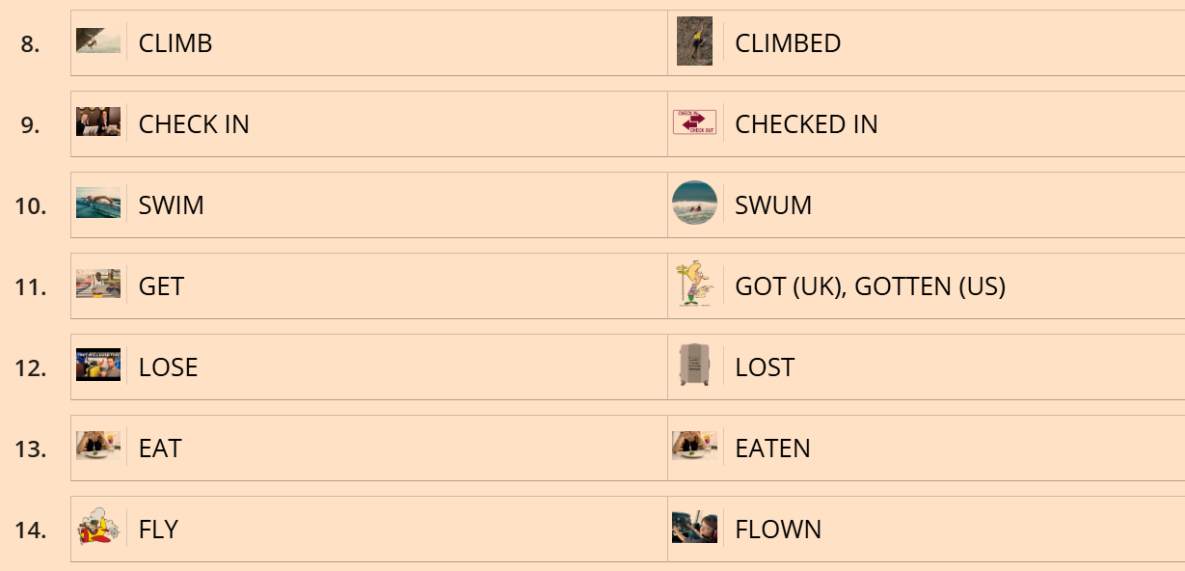

FOR TEACHERS ONLY:
1. You can use the flashcard below to check the students’ knowledge of some most common verbs
related to travelling.
Copy and paste the link into your browser and share screen if you can.
Alternatively use the next slide containing the following verbs:
https://www.iheartenglish2.co.uk/teaching-resources
2. For higher level learners, you can encourage students to form sentences based on what they can see on the pictures. Or you can ask questions. For example:
Flashcard 6: GET
Have you ever gotten (got) lost when you were travelling?
What happened?

Slide 9
Put the verbs below in the correct category and make a past participle.
TRAVEL, VISIT, GO, SEE, TAKE, BOOK, PLAN, CLIMB, CHECK IN, SWIM, GET, LOSE, EAT, FLY, CLIMB, CHECK IN, SWIM, GET, LOSE, EAT, FLY
REGULAR VERBS | IRREGULAR VERBS

Slide 10
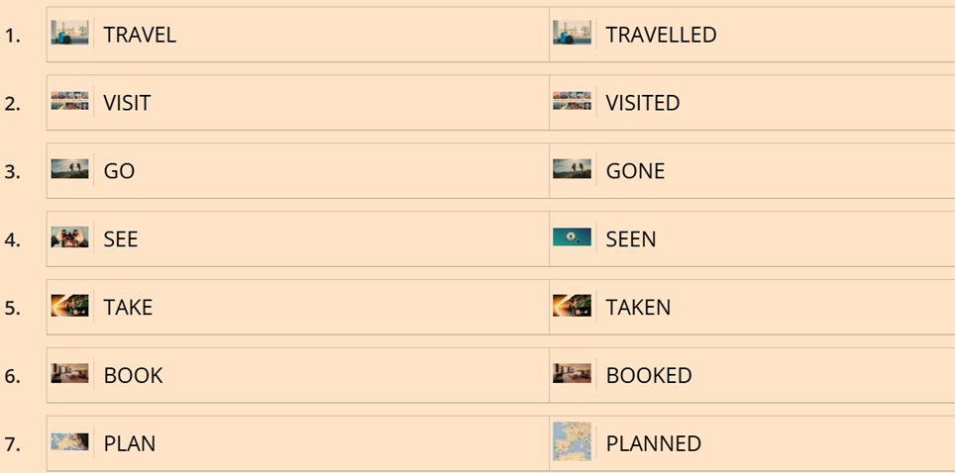
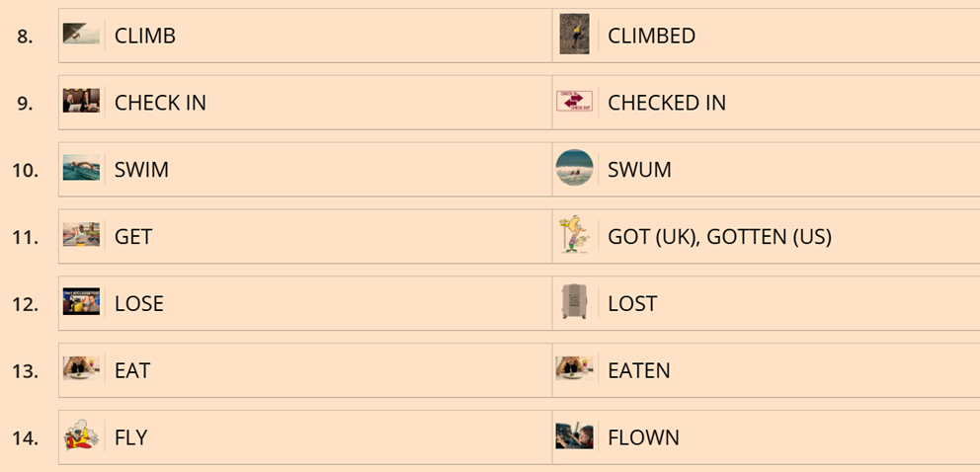
Put the verbs below in the correct category and make a past participle.
TRAVEL, VISIT, GO, SEE, TAKE, BOOK, PLAN, CLIMB, CHECK IN, SWIM, GET, LOSE, EAT, FLY, CLIMB, CHECK IN, SWIM, GET, LOSE, EAT, FLY
CORRECT RESPONSES:

Slide 11










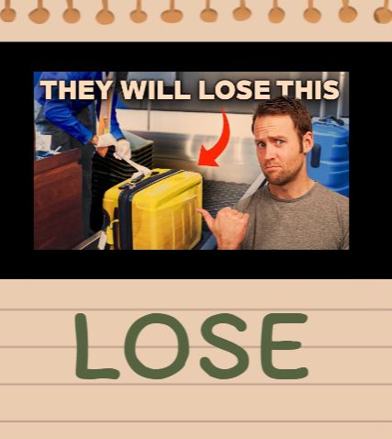



Change the verbs below into a past participle
and answer your teacher’s questions.

Slide 12
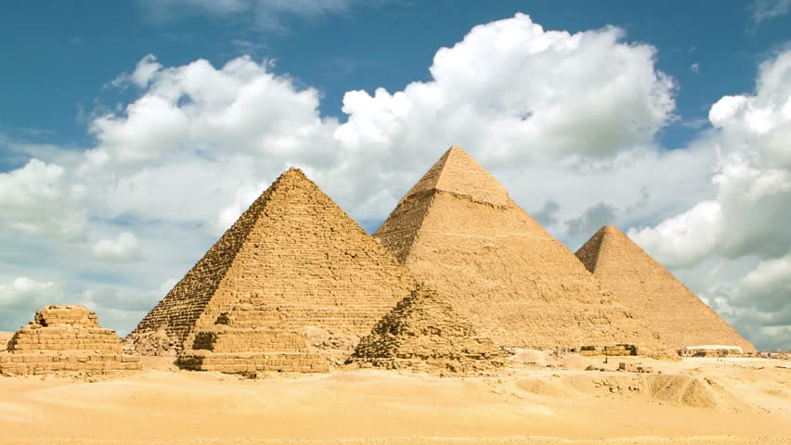
Change the verbs (please see images below) into a past participle and answer the questions.
What other verbs could you use instead?
Have you ever ___________any unusual foods? What was it?
Have you ever ___________ a trip to another country? Where?
What countries have you _________ so far?
Have you ever ______________when you were travelling? What happened?
Have you ever ___________ a mountain? Where?
Have you ever ___________ more than two weeks off?
Have you ever ___________ a helicopter or a plain? How was it?
Have you ever ___________ alone? Where have you _________?
Have you ever ___________ hiking alone? Where?
Have you ever ____________ in the ocean? Where?
Have you ever ___________ the Egyptian pyramids?

Slide 13
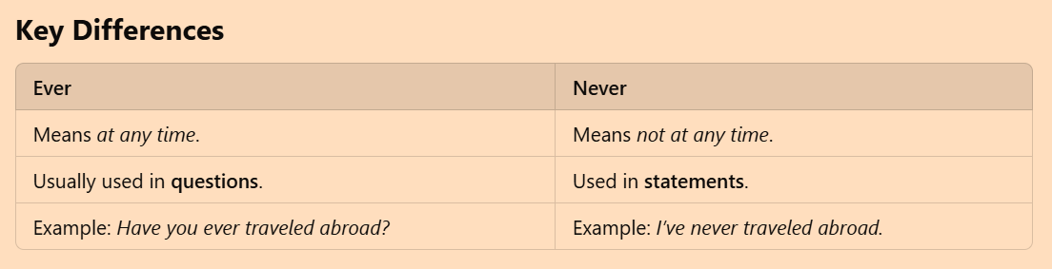
EVER/NEVER
EVER means at any time in your life until now. It is used to ask questions about other people’s experiences.
- It is used in QUESTIONS.
Have you ever travelled abroad?
NEVER means not at any time.
- It is used in positive statements to give a negative meaning.
I have never been to Japan.
(At no time in my life have I been to Japan.)

Slide 14
MOST COMMON MISTAKES THE LEARNERS MAKE
Using "never" and "not" together:
Incorrect: I haven’t never been to Spain.
Correct: I have never been to Spain.
Using "ever" in positive sentences (outside questions):
Incorrect: I have ever watched that movie.
Correct: I have never watched that movie.
Forgetting the helping verb "have/has":
Incorrect: I never seen that film.
Correct: I have never seen that film.

Slide 15
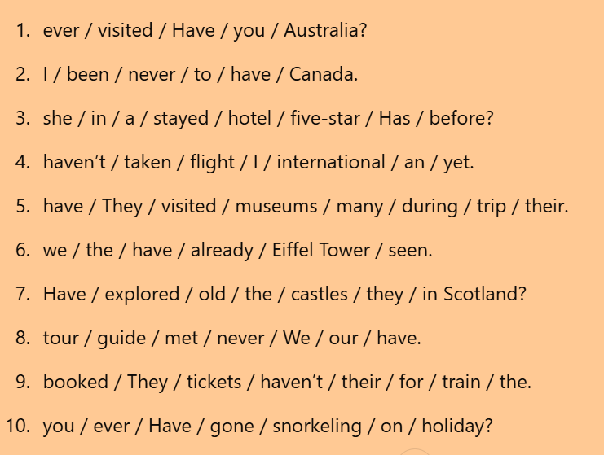

Slide 16
Answers
Have you ever visited Australia?
I have never been to Canada.
Has she stayed in a five-star hotel before?
I haven’t taken an international flight yet.
They have visited many museums during their trip.
We have already seen the Eiffel Tower.
Have they explored the old castles in Scotland?
We have never met our tour guide.
They haven’t booked their tickets for the train.
Have you ever gone snorkelling on holiday?

Slide 17
Each sentence below contains a mistake. Rewrite the sentence correctly using the present perfect tense.
1. I has eat in a famous restaurant in Paris.
2. She have already plan her trip to Italy.
3. We hasn’t travel to Asia before.
4. Have they ever see the pyramids in Egypt?
5. He has get lost in the city two times now.
6. They have went to the beach every summer.
7. We have climb Mount Fuji.
8. I has visit five countries this year.
9. You have never fly in a private jet before?
10. He have booked the tickets for the cruise.

Slide 18
Answers
I have eaten in a famous restaurant in Paris.
She has already planned her trip to Italy.
We haven’t travelled to Asia before.
Have they ever seen the pyramids in Egypt?
He has gotten/got lost in the city two times now.
They have gone to the beach every summer.
We have climbed Mount Fuji.
I have visited five countries this year.
Have you ever flown in a private jet before?
He has booked the tickets for the cruise.

Slide 19
For teachers only.
Speaking practice. Please copy and paste into your browser or visit our website and share your screen.
https://www.iheartenglish2.co.uk/teaching-resources

Slide 20
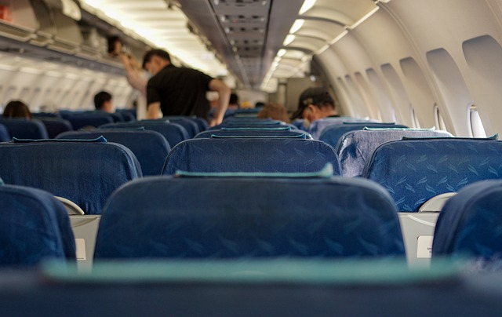
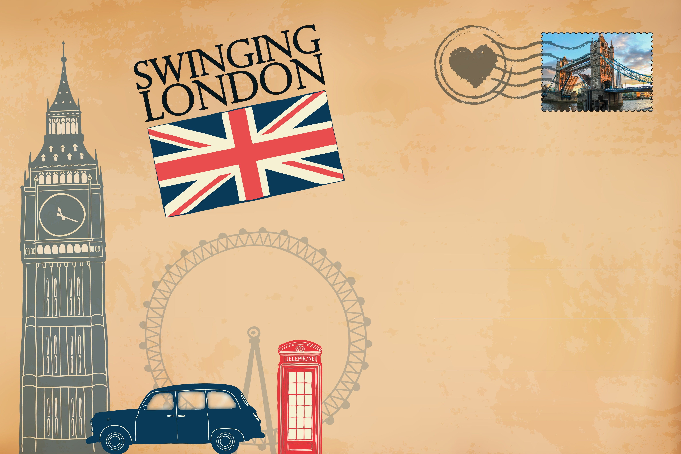

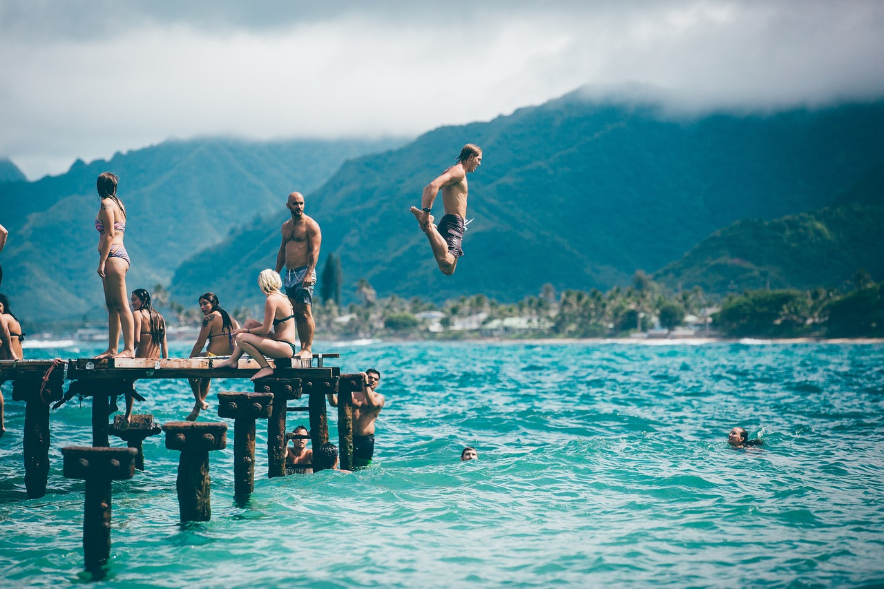
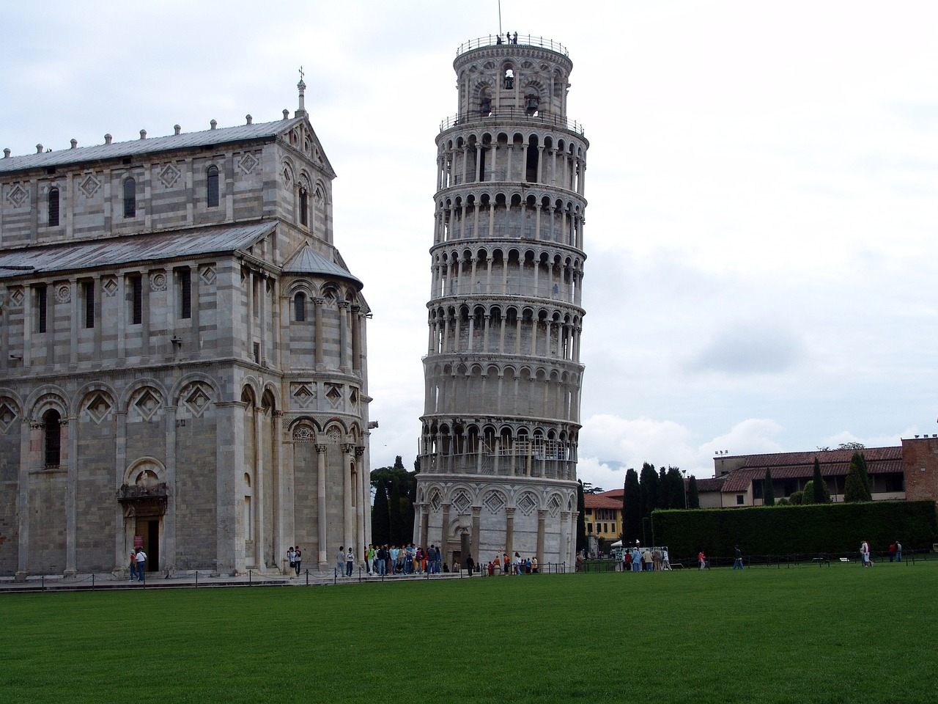
Pair work or group work
SPEAKING PRACTICE:
Learn more about your classmates’ experiences.
Student A: Ask your classmate a question about their experiences related to travelling
using present perfect tense. If you need some help, look at the pictures for ideas.
Student B: Answer the question, then ask a question to continue the conversation.
EXAMPLE:
Student A: Have you ever been
To the USA before?
Student B: No, I haven’t.
What about you?
Student A: Yes, I have.
……..

